Slide 1
Tutorial #6 H8s/2377 Mode
Dr. Sundaram Suresh Microprocessor Programming

Slide 2
MCU Operating Modes
H8S Family
H8S/2378R 0.18μm F-ZTAT Group have six operating modes (modes 1 to 5 and 7).
The H8S/2377 and H8S/2377R have five operating modes (modes 1 to 4 and 7).
The H8S/2375 and H8S/2375R has four operating modes (modes 1, 2, 4, and 7).
The H8S/2373 and H8S/2373R has two operating modes (modes 1 and 2).
The operating mode is selected by the setting of mode pins (MD2 to MD0).

Slide 3
H8S/2377 Operating Modes
Modes 1, 2, and 4 are externally expanded modes in which the CPU can access an external memory and peripheral devices.
In the externally expanded mode, each area can be switched to 8-bit or 16-bit address space by the bus controller.
If any one of the areas is set to 16-bit address space, the bus mode is 16 bits.
If all areas are set to 8-bit address space, the bus mode is 8 bits.
Mode 7 is a single-chip activation externally expanded mode in which the CPU can switch to access an external memory and peripheral devices at the beginning of a program execution.
Mode 3 is a boot mode in which the flash memory can be programmed or erased.
The settings for pins MD2 to MD0 should not be changed during operation.

Slide 4
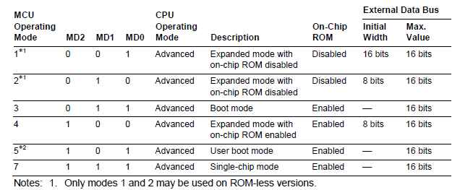
H8S/2377 Operating Mode Selection

Slide 5
Mode Description
Mode 1
The CPU can access a 16-Mbyte address space in advanced mode.
The on-chip ROM is disabled.
Ports A, B, and C function as an address bus.
Ports D and E function as a data bus
and parts of ports F and G carry bus control signals.
The initial bus mode after a reset is 16 bits, with 16-bit access to all areas.
However, if 8-bit access is designated for all areas by the bus controller, the bus mode switches to 8 bits.

Slide 6
Mode Description
Mode 2
The CPU can access a 16-Mbyte address space in advanced mode.
The on-chip ROM is disabled.
Ports A, B, and C function as an address bus,
ports D and E function as a data bus,
and parts of ports F and G carry bus control signals.
The initial bus mode after a reset is 8 bits, with 8-bit access to all areas.
However, if 16-bit access is designated for any one of the areas by the bus controller, the bus mode switches to 16 bits and port E functions as a data bus.

Slide 7
Mode Description
Mode 3
This mode is a boot mode of the flash memory.
This mode is the same as mode 7, except for the programming and erasure on the flash memory.
Mode 3 is only available in the flash memory version.

Slide 8
Mode Description
Mode 4
The CPU can access a 16-Mbyte address space in advanced mode.
The on-chip ROM is enabled.
The program in the on-chip ROM connected to the first half of area 0 is executed.
Ports A, B, and C function as input ports immediately after a reset,
but can be set to function as an address bus depending on each port register setting.
Ports D functions as a data bus,
and parts of ports F and G carry bus control signals.
The initial bus mode after a reset is 8 bits, with 8-bit access to all areas.
However, if 16-bit access is designated for any area by the bus controller, the bus mode switches to 16 bits and port E functions as a data bus.

Slide 9
Mode Description
Mode 5
This mode is a user boot mode of the flash memory.
This mode is the same as mode 7, except for the programming and erasure on the flash memory.
Mode 5 is only available in the H8S/2378 0.18μm F-ZTAT Group and H8S/2378R 0.18μm F-ZTAT Group.

Slide 10
Mode Description
Mode 7
The CPU can access a 16-Mbyte address space in advanced mode.
The on-chip ROM is enabled, and the chip starts up in single-chip mode.
External address space cannot be used in single-chip mode.
The initial mode after a reset is single-chip mode, with all I/O ports available for use as input/output ports.
However, the mode can be switched to externally expanded mode by setting 1 to the EXPE bit of SYSCR and then the external address space is enabled.
When externally expanded mode is selected, all areas are initially designated as 16-bit access space.
The functions of pins in ports A to G are the same as in externally expanded mode with on-chip ROM enabled.

Slide 11
System Control Register (SYSCR)
SYSCR controls CPU access to the flash memory control registers, sets external bus mode, and enables or disables on-chip RAM.

Slide 12
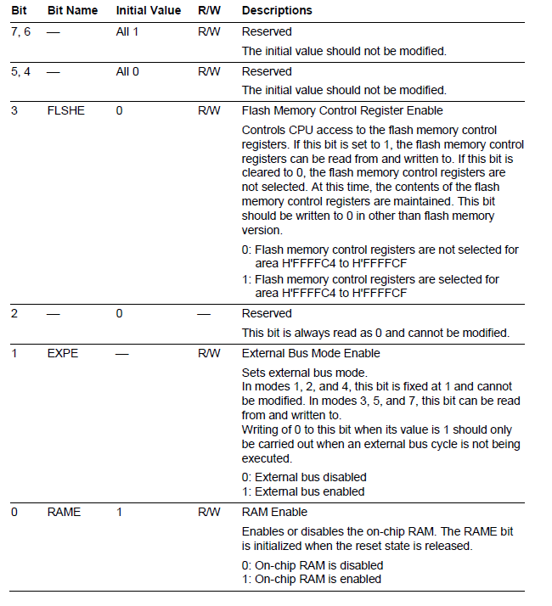
SYSCR

Slide 13
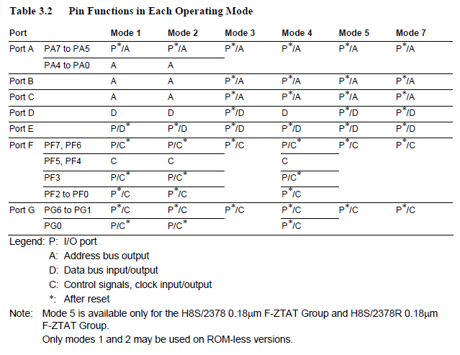
Pin Functions

Slide 14
PORT B
Port B is an 8-bit I/O port that also has other functions.
The port B has the following registers.
Port B data direction register (PBDDR)
Port B data register (PBDR)
Port B register (PORTB)
Port B pull-up MOS control register (PBPCR)

Slide 15
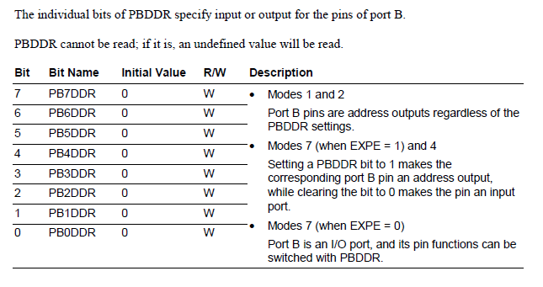
PBDDR

Slide 16
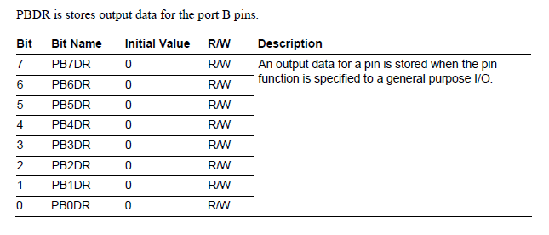
PBDR

Slide 17
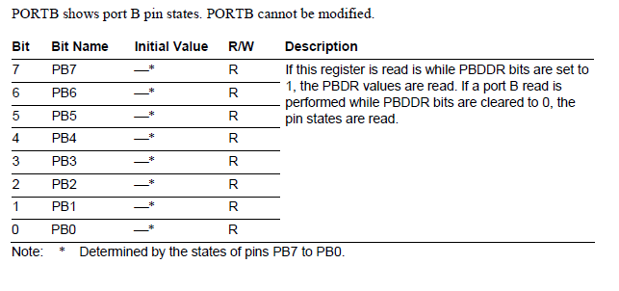
PORT B

Slide 18
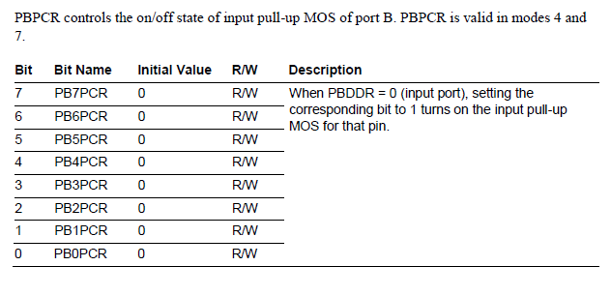
PBPCR

Slide 19
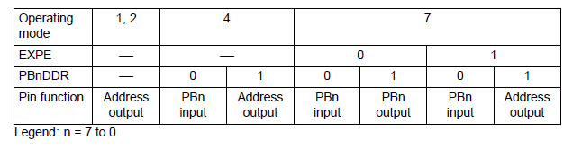
PORT B Pin Functions
Port B pins also function as the pins for address outputs.
The correspondence between the register specification and the pin functions is shown below.
PB7/A15, PB6/A14, PB5/A13, PB4/A12, PB3/A11, PB2/A10, PB1/A9, PB0/A8
The pin function is switched as shown in Fig. according to the operating mode, bit EXPE, and bit PBDDR.

